Slide 1
GSR BOOT CAMP
February 6, 2021

Slide 2
Who the GSR is and what do they do?
  Overview – Roles and Responsibilities (how do you define GSR – Two Way Communication)
  Role of Alternate GSR
  Definitions of Acronyms
  GSR Pamphlet / Service Manual / Circles of Love in Service – what are the resources?
  How they fit into the bigger picture.

Slide 3
The General Service
Representative (G.S.R.)

Slide 4
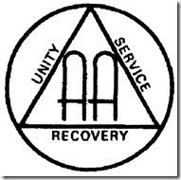

Why???
Everything we do is to help the alcoholic who still suffers
It’s up to you to keep two-way communication going be- tween your group and the Conference.

Slide 5

The General Service
Representative (G.S.R.)
The strength of our whole A.A. service structure starts with the group and with the general service representative (G.S.R.) the group elects. We cannot emphasize too strongly the G.S.R.’s importance

Slide 6
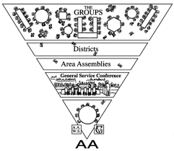
definition OF GSR
G.S.R. — General service representative. The group contact with the General Service Office; voting member of the area assembly.

Slide 7
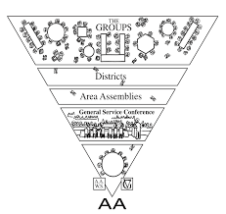
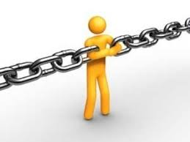
The General Service
Representative (G.S.R.)
The general service representative has the job of linking his or her group with A.A. as a whole.

Slide 8



The General Service
Representative (G.S.R.)
The G.S.R. represents the voice of the group conscience, reporting the group’s thoughts to the district committee member and to the delegate, who passes them on to the Conference.

Slide 9

The General Service
Representative (G.S.R.)
This communication is a two-way street, making the G.S.R. responsible for bringing back to the group Conference Actions that affect A.A. unity, health, and growth.

Slide 10

The General Service
Representative (G.S.R.)
Only when a G.S.R. keeps the group informed, and communicates the group conscience, can the Conference truly act for A.A. as a whole.

Slide 11

alternate GSR
ALTERNATE G.S.R.: An alternate should be elected at the same time, in case the G.S.R. is unable to attend all district and area meetings.
Alternates should be encouraged to assist, participate, and share in the responsibilities of the G.S.R., attending district and area meetings when feasible, depending on local needs.

Slide 12
ROLES & RESPONSIBILITIES
G.S.R.s attend district meetings.
They also attend area assemblies.
They serve as mail contact for group.
They participate in district and area service meetings, and often help with planning for area get-togethers and conventions. Following these events, they make reports to their groups for the benefit of those who could not attend.
They are the guardian of the traditions.

Slide 13
Definitions of Acronyms
D.C.M. — District committee member. An experienced G.S.R. elected by other G.S.R.s to represent the groups of their district in area committee meetings and to coordinate Service activities in the district.
G.S.O. — The General Service Office, which provides services to groups in the U.S. and Canada and publishes A.A. literature.
G.S.R. — General service representative. The group contact with the General Service Office; voting member of the area assembly

Slide 14
Definitions of Acronyms
GVR — Grapevine representative: the group or district contact with the Grapevine office.
RLV — La Vina representative; the group or district contact with the Grapevine office.
P.I. — Public information. P.I. committees help carry the message by working with the media.
C.P.C. — Cooperation with the professional community help carry the message by working with professionals.

Slide 15
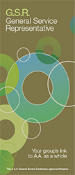
GSR Pamphlet
“You transmit ideas and opinions, as well as facts; through you, the group con- science becomes a part of “the collective con- science of our whole Fellowship.”
https://www.aa.org/assets/en_us/general-service-representative-gsr/p-19-gsr-may-be-the-most-important-job-in-aa

Slide 16
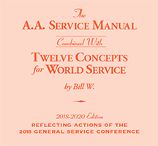
Service Manual
“Our Twelfth Step — carrying the message — is the basic service that the A.A. Fellowship gives; this is our principal aim and the main reason for our existence."
https://www.aa.org/assets/en_us/en_bm-31.pdf

Slide 17

Circles of Love in Service
“A.A. is made up of interconnected circles of people within the Fellowship, who work together to carry A.A.’s message of hope.”
https://www.aa.org/assets/en_us/p-45_circleoflove.pdf

