Slide 1
South Florida Area 15 District 4
Website Disaster Recovery: A story on How to (or not to) recover and tips for prevention
9.18.23

Slide 2
Agenda
INTRODUCTION
WHAT IT WAS LIKE
WHAT HAPPENED
WHAT IT’S LIKE NOW
CLOSING

Slide 3
INTRODUCTION
HOW DID WE GET HERE?
In 2018 - District 4 General Service wanted it’s own website, formed a Website Committee, and began discussion on requirements
In 4Q 2019 the Website Committee got a new Chairperson and Webservant – we had a very little budget and the home page requirement was roughly drawn on a piece of paper with the instruction “make it look like the Area 15 site”
The dist4gsaa.org prototype site was up for testing in November 2019, and went live in January 2020!
We had some previous experience, but were not experts at any of this, so…

Slide 4
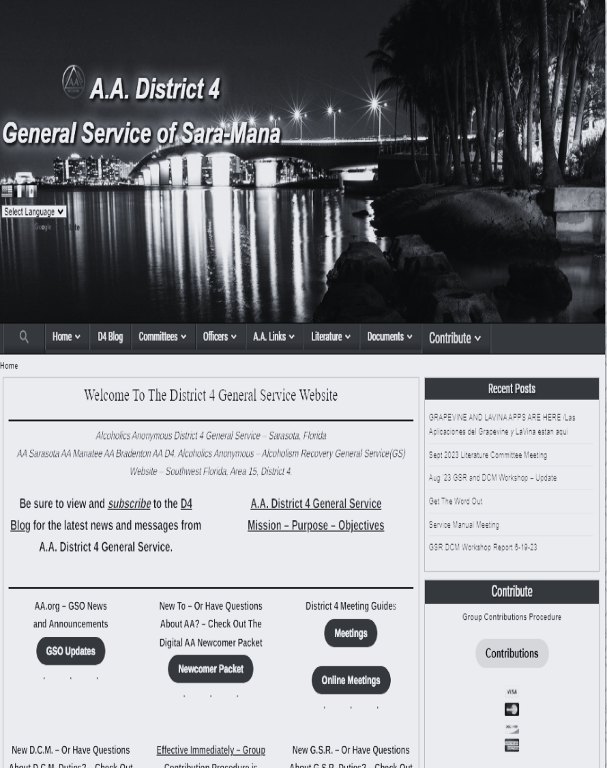
What it was like
WE WERE SO PROUD!
The dist4gsaa.org went live in January 2020!
We implemented basic maintenance and security functionality – backups and various security protocols to defend the site against hacker attacks, spam, trojans, and malware
Covid-19 lockdowns hit, so we began expanding site to provide as much digital content as possible to D4 GSRs, DCMs, ACMs that they would normally get from GSO or Central Office – we saw site usage increase!
Links to in-person and online meetings info
AA Newcomer Packet
GSR Kit
DCM Kit
Links to Literature, GSO, Area 15, and neighboring Districts websites to name a few

Slide 5
What happened
PRIDE GOETH BEFORE THE FALL
All was running smoothly until March 2022, when the site was hacked with a change to a Chinese language page for the Calendar page
We took the site offline and investigated what happened. We found the page in question was modified that same morning – so we potentially had 3 good user backups of the site. We couldn’t tell how the hack was applied nor could we find any other pages impacted
We were lucky this was noticed and reported right away – had we not known for more than 3 days we would not have a viable user backup of the site. We would have had only a host backup which is overwritten monthly
So we tried to restore to an earlier date – but that failed because…

Slide 6
What happened
PRIDE GOETH BEFORE THE FALL
There was something else wrong with the site, critical file permissions were altered, and the hack was preventing normal functioning of the restore process
We contacted our Host provider to report the hack and ask for assistance - their response was underwhelming. They could provide a restore of our site from the most recent backup - which was almost a month old – within 3-5 business days – for a cost of $99
They also had their site security team contact us the next day (seemed like an eternity) and offered to implement SiteLock service for a cost of $399 annually
The solutions offered by our Host provider were unacceptable to me, so I made a decision to completely delete and then restore the site with one of our recent backups

Slide 7
What happened
PRIDE GOETH BEFORE THE FALL
Our site was back up the next day – 2 days from when the hack was noticed – but…
Deleting the site also deleted all of our email accounts. We lost the webmail history and had to recreate all the email accounts
Our website was back up and running with minimal loss of site content in 2 days
The admin access URLs were changed and all users account passwords were changed with STRONG replacements
The decision to delete and restore the site which caused loss of District email access for a short period, and 13 months of email history was EGO driven. This was making me look bad!

Slide 8
What happened
PRIDE GOETH BEFORE THE FALL
I THOUGHT we had good layered security
I THOUGHT manual malware scanning was enough
I THOUGHT we could rely on our host provider for help
I THOUGHT that this was my fault
I WAS WRONG!
Nobody knows exactly how many WordPress websites get hacked, but one estimate is at least 13,000 per day. That’s around 9 per minute, 390,000 per month, and 4.7 million per year
We need to be smarter about Security!

Slide 9
What it’s like now
WE HOPE TO HAVE LEARNED
We’ve prioritized layered site security
The biggest change to our site is that we utilize MalCare ($99/yr. and Ninja Firewall/free) that have the following functionality
Web based firewalls that stand in front of WordPress traffic that filter - hook, scan, sanitize or reject every HTTP/HTTPS request sent, before they reach WordPress or any of its plugins. All scripts located inside the site installation directories and sub-directories are protected, including those that aren’t part of the WordPress package. Even encoded PHP scripts, hackers shell scripts and backdoors are filtered
Real time alerts
Automated daily Malware scanning and immediate removal of any detections

Slide 10
What it’s like now
WE HOPE TO HAVE LEARNED
We keep up-to-date with our WordPress Website Maintenance Tasks
Daily automated backups and weekly snapshots saved off- site on our google drive
Automated WordPress updates including up-to-date PHP
Automated plugin and Theme updates
No inactive plugins or Themes
among many others…
We’ve had no recurrence of malware or hacks
We’re also moving to a new Host Provider
I hope this information is helpful to the Districts that utilize WordPress. Back in 2021 I determined that 76% (22 of 29) of the Area 15 Districts websites are WordPress

Slide 11
THANK YOU
Chris M
+1 (847) 445-2920
tech@dist4gsaa.org

