Slide 1
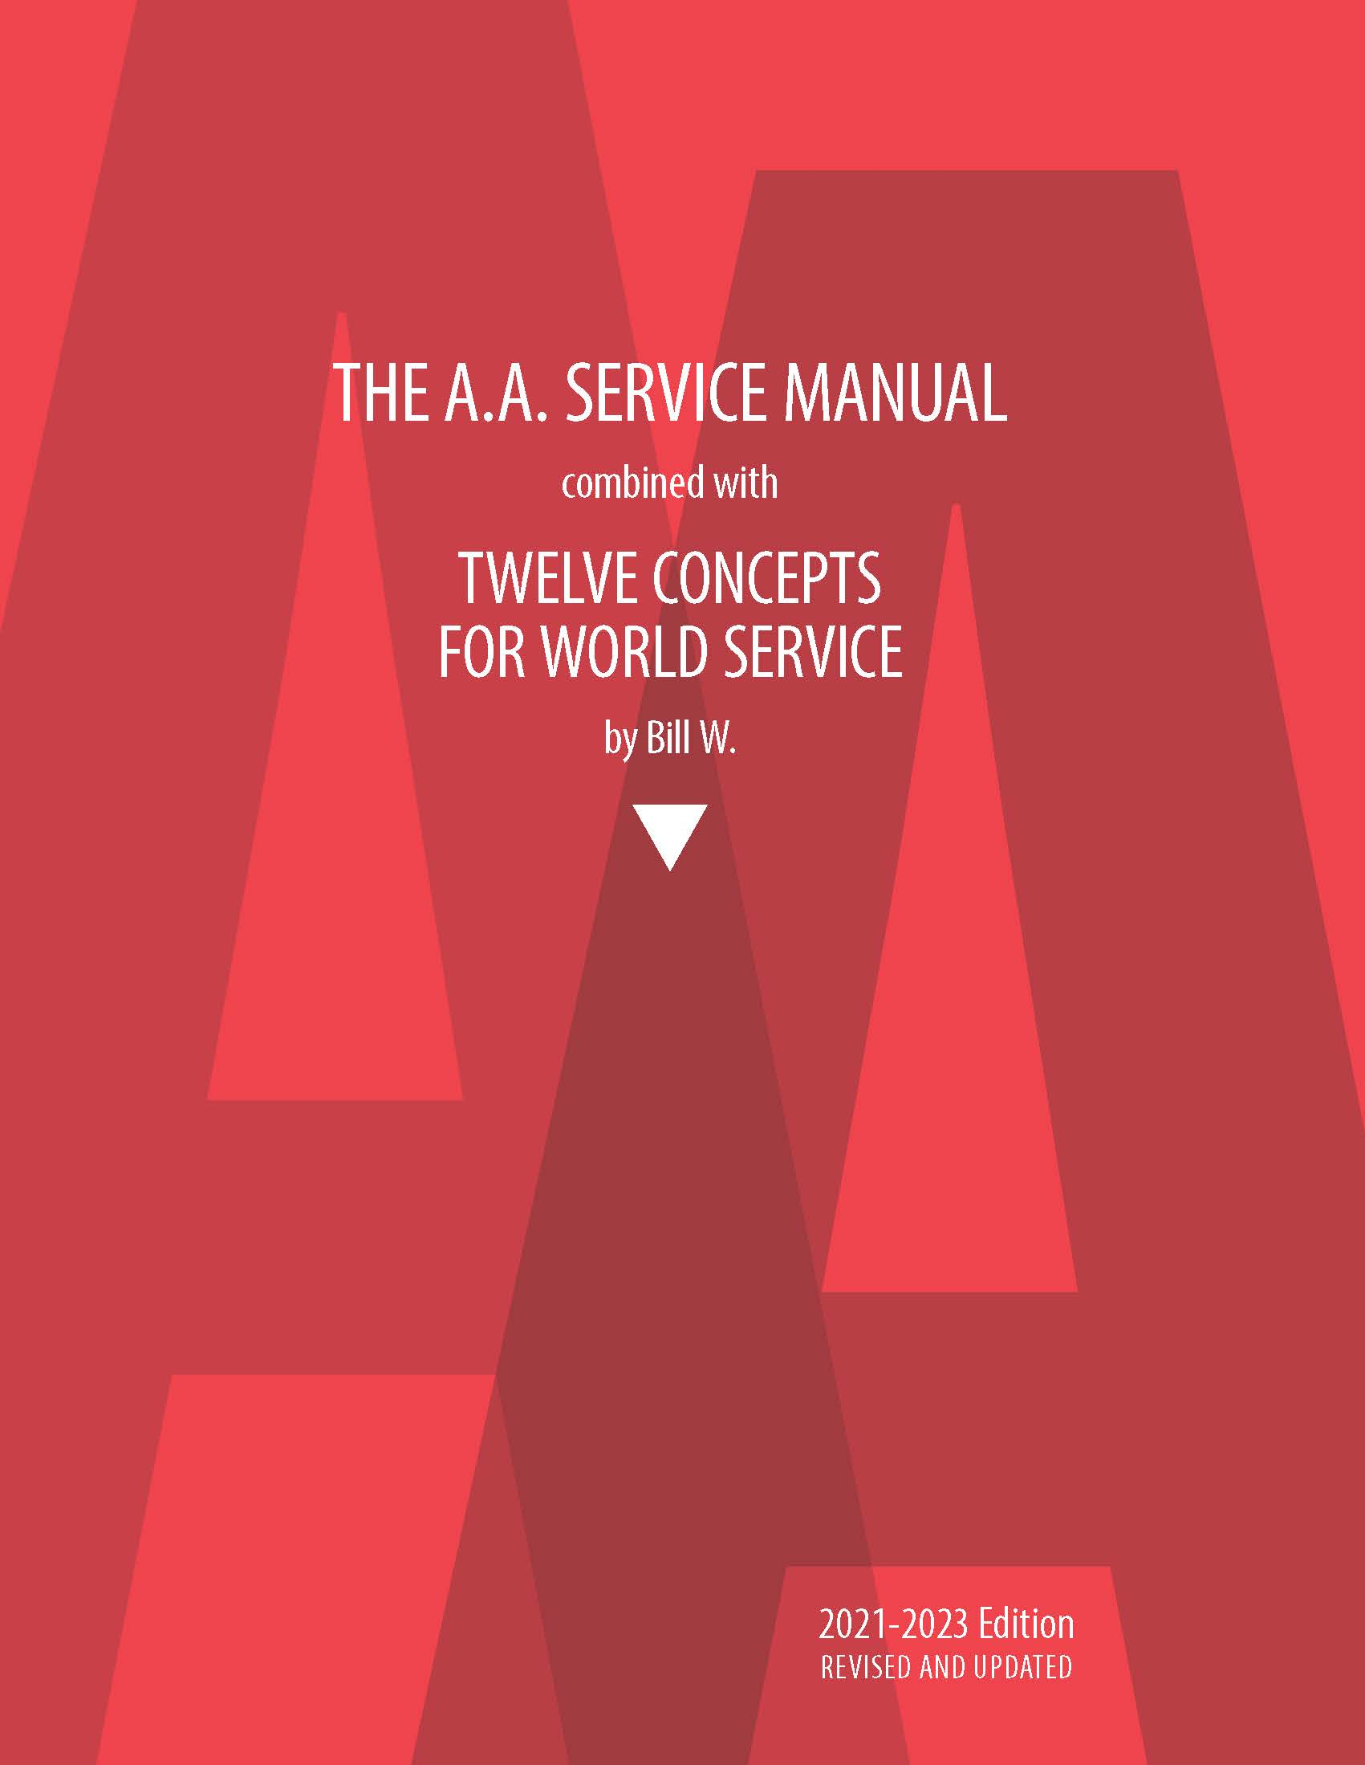
Service Manual Workshop Chapter 3 The Area and its Activities
Alcoholics Anonymous
Area 15
Outreach Committee

Slide 2
The A.A. Service Manual
Chapter 1 -The Group and its General Service Representative
Chapter 2 -The District and the District Committee Member
Chapter 3 -The Area Assembly and it’s Activities
Chapter 4 - The Area Committee
Chapter 5 -The Delegate
Chapter 6 -The Annual General Service Conference
Chapter 7 – Conference Committees
Chapter 8 -The General Service Board
Chapter 9 -The Board’s Operating Corporations
Chapter 10 -The General Service Office
Chapter 11 -A.A. World Services, Inc.
Chapter 12 -A.A. Grapevine, Inc.

Slide 3
Chapter 3 – The Area Assembly and its Activities
“An outstanding characteristic of every good operational structure is that it
guarantees harmonious and effective function by relating its several parts and
people in such a way that none can doubt what their respective responsibilities
and corresponding authorities actually are. Unless these attributes are well
defined; unless those holding the final authority are able and willing properly to
delegate and maintain a suitable operational authority; unless those holding such
delegated authority feel able and willing to use their delegated authority freely
as trusted servants; and unless there exists some definite means of interpreting
and deciding doubtful situations — then personal clashes, confusion, and
ineffectiveness will be inevitable.” — Concept X
The A.A. Service Manual, p. 18

Slide 4
The “Upside Down” Triangle

Slide 5
Chapter 3 – The Area Assembly and its Activities
The Area
The area holds periodic assemblies that include GSRs and DCMs as voting members. Assembly schedules and agendas are based on local autonomy and group conscience. Information about them can often be obtained from DCMs or other area trusted servants. The area handles a wide range of concerns, and one of the most important functions is electing the delegate to represent the area at the annual General Service Conference.
(Area 15 includes South Florida, Bahamas, US and British Virgin Islands, Antigua, St Maarten and Cayman Islands)
The A.A. Service Manual, p. 4

Slide 6
Chapter 3 – The Area Assembly and its Activities
The Area
At the heart of each area is the assembly meeting, where the democratic voice of our Fellowship expresses itself. While each area has the autonomy to conduct its meetings according to its conscience, Concept XII offers the General Warranties of the Conference as the guiding principles to remain democratic in thought and action.
Area 15 includes South Florida, Bahamas, US and British Virgin Islands, Antigua, St Maartenand Cayman Islands
The A.A. Service Manual, p. 18

Slide 7
Chapter 3 – The Area Assembly and its Activities

Slide 8
Chapter 3 – The Area Assembly and its Activities

Slide 9
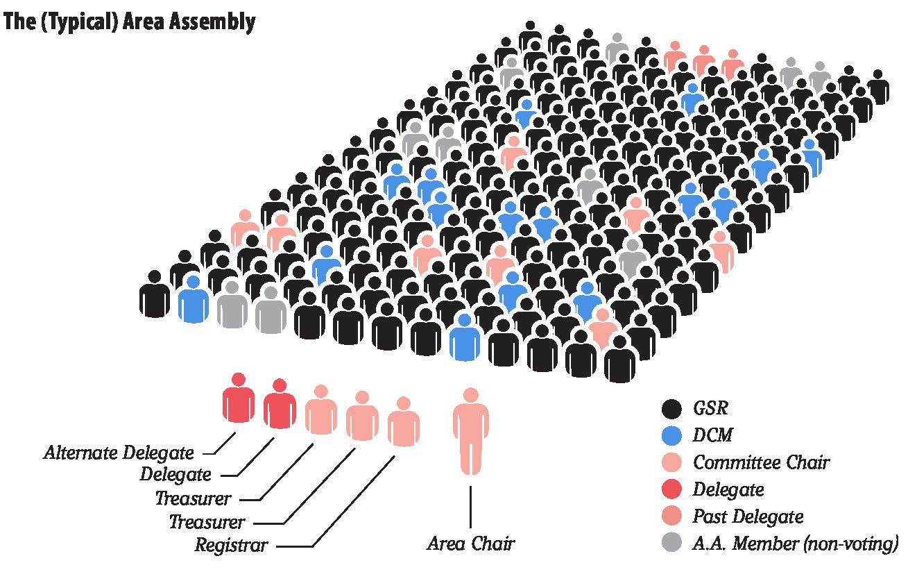
Chapter 3 – The Area Assembly and its Activities
The Area – Composition
GSRs — representing the conscience of the groups in the area
DCMs — representing the conscience of the districts in the area
Area officers — elected by the GSRs and DCMs to serve the area
Area committee chairs — typically appointed by the area chair or elected by the assembly
Area delegate — elected to represent the conscience of the area at the annual General Service Conference meeting
Past Delegates -- In some areas, past delegates are also members of the Assembly, with a voice and (sometimes) a vote.
The A.A. Service Manual, p.p.18-19

Slide 10
Chapter 3 – The Area Assembly and its Activities
Purpose
Not all areas operate in the same way, generally the Area’s purposes include:
To elect a delegate who will represent the area’s conscience at the annual General Service Conference, where decisions are made that affect A.A. throughout the U.S. & Canada.
To form a local decision-making structure so groups can collectively decide on matters that affect their area.
To carry out Twelfth Step work that may not be practical for groups, districts or intergroups to take on by themselves.
The A.A. Service Manual, p. 19

Slide 11
Chapter 3 – The Area Assembly and its Activities
Composition
Trusted servants typically voting members of an area assembly (may vary by area):
GSRs — representing the conscience of the groups in the area
DCMs — representing the conscience of the districts in the area
Area officers — elected by the GSRs and DCMs to serve the area
Area committee chairs — typically appointed by the area chair or elected by the assembly
Area delegate — elected to represent the conscience of the area at the annual General Service Conference meeting
Area 15 – See 1.2 of the Book of Current Practices
The A.A. Service Manual, p. 19

Slide 12
Chapter 3 – The Area Assembly and its Activities
Election Assemblies
Held once every two years, the delegate is elected, typically, along with area officers. It is common for little or no other business to be conducted. In an election year, this assembly is usually scheduled in the fall, with the new cycle beginning in January (See Appendix M for information on Conference panels).
Area 15 – Odd year panel.
Carey W. in Panel 73
The A.A. Service Manual, p. 19

Slide 13
Chapter 3 – The Area Assembly and its Activities
Regular (Non-Election) Assemblies
This kind of meeting is typically held multiple times during the year and may take different forms. Each area decides for itself on the number — and interval between — meetings.
In some areas, a “regular” assembly meeting may be called a “workshop” or “general sharing session.”
Some areas appoint agenda committees, which may include the officers and GSRs.
Some areas choose to keep business to a minimum and use most of the time for sharing sessions or workshops.
Special speakers who have experience with general service may also be invited to shed light on worldwide services.
The A.A. Service Manual, p. 19

Slide 14
Chapter 3 – The Area Assembly and its Activities
Practice and Procedure
“In the spirit of area autonomy, typical practices and procedures discussed here are in no way obligatory, and, in some instances, may be impractical. It is important for each area to agree for itself on how it will operate.”
Questions:
Do the chairs of special committees have a vote?
How long must a group have been in existence before its GSR can vote?
Can one GSR represent two groups?
When the GSR cannot be present, are they allowed to vote by proxy?
Do GSRs of prison and hospital groups have a vote?
The A.A. Service Manual, p. 20

Slide 15
Chapter 3 – The Area Assembly and its Activities
Timing and Location of Assemblies
Most areas hold assembly meetings quarterly or every other month (a few meet monthly). When travel distances are great, assemblies may be held semiannually or even annually.
Assemblies may run from half a day to a full weekend.
Area 15 meets quarterly, in January, April, July and October for a weekend
Locations are found by the Quarterly Coordinator Committee and voted on by the body – Districts bid to “host” each assembly
The A.A. Service Manual, p. 20

Slide 16
Chapter 3 – The Area Assembly and its Activities
Area Activities
The Annual Conference Program
“…one of the most important items for an assembly program is a good look at the agenda of every General Service Conference. Assemblies and district meetings provide an ideal time to find out problems and solutions that are shared by A.A. groups everywhere.”
“And after the Conference, area assemblies and district meetings are occasions for hearing full reports on what took place at the Conference, asking questions of the delegate, and deciding what may need attention at future Conferences.”
The A.A. Service Manual, p. 21

Slide 17
Chapter 3 – The Area Assembly and its Activities
Area Activities
Sharing Sessions
In an area sharing session, everyone has a chance to use their experience, strength and hope to contribute ideas and opinions about the welfare of A.A. (This can be useful at district meetings as well.)
Page 21 has a suggested format and suggested topics, sharing sessions can result in useful ideas to bring back to district meetings.
Area Archives
Area Newsletters and Bulletins
The A.A. Service Manual, p. 22

Slide 18
Chapter 3 – The Area Assembly and its Activities
Area Activities
Conventions
They are frequently set up and guided by area committees or by special committees appointed by area chairs. Usually, assembly meetings are not held during conventions, but occasionally they can take place just before or after.
Area Websites
Suggested guidelines on page 23
The A.A. Service Manual, p. 23

Slide 19
Chapter 3 – The Area Assembly and its Activities
Working With Intergroups/Central Offices
Traditionally Intergroup/central offices provide local services, while general service committees maintain the link between A.A. groups and the General Service Board by means of the Conference. (Some parts of the U.S./Canada structure may not have an intergroup/central office.)
Many areas find that a liaison between the intergroup/central offices and the area committee is very helpful in maintaining good relations and communication. In some areas the liaison has a vote at the assembly; in others, a voice, but no vote.
The A.A. Service Manual, p. 19

Slide 20
Area No./State | Number of Area Meetings each year | Area Meeting Hybrid yes/no | Number of Area Assemblies each year | Area Assemblies Hybrid yes/no | Assembly one day or weekend | Assembly Approximate Attendance
30 | 12 | Yes | 5 | Yes | One day | 75-125
66 | 0 (Area Officers meet 4 times a year) | No | 4 in the even year – 3 in the odd year | No | Even-numbered years: 1 day assembly orientation for new DCM’s, GSR’s, and new Area Officers; 3 weekend assemblies held in Odd-numbered years: 3 weekend assemblies | 75
13 | 12 | Yes | 4 | Yes | One day | 50
62 S. Carolina | 4-3 | No | 3 | No | Weekend | 200
09 Mid SoCal | 6 | Yes | 3 on even years – 4 on odd years | Yes | One day – second Sund of the month (adjusted for holidays – Mother’s Day) | 125 In person; 60-90 online
65 NE Texas | 4 | Yes | 3 | Yes | Weekend | 225
29 | 9 | Yes | 5 | Yes | One Day | 75
4 Arkansas
43 NH | 8 | Virtual Only | 4 | Hybrid | Day | 100
39 Western Missouri | 0 |  | 4 | Hybrid | 2 Days
Area No./State | Number of Area Meetings each year | Area Meeting Hybrid yes/no | Number of Area Assemblies each year | Area Assemblies Hybrid yes/no | Assembly one day or weekend | Assembly Approximate Attendance
24 | 2 | Yes | 5
51 S. Carolina | 4 | No | 2 | No | Weekend | 350-400
76 | 12 | All Virtual | 2 | No | Weekend | 120
10 | 3 | No | 3 | No | Weekend | 350
11 CT | 10 (6 business meetings and 4 sharing sessions | All Virtual | 3 | Yes | One Day | 150-250
08 So. Cal Imperial County | 12 | Yes | 5 | Yes | One Day | 100-175
59 E. PA | 4 | No | 1 | No | Weekend | 300-500 voting members
06 NorCal Coastal | 12 | Yes | 4 | Yes | One Day – 3 Two Day – 1 | 300-450
86 | Panel Yr 1 – 3 Panel Yr 2 – 4 | No | 2 | No | Weekend | 250-300
19 Chicago (Cook County) | 6 | Yes | 6 | Yes | One Day | 100
69 Utah | 3 | Yes | 3 | Yes | Weekend | 100
35 N MN | 4 | No | 2 | No | Weekend | 90-130
75 S WI | 5 | Virtual only | 5 |  | (Winter assembly online only due to weather) – others hybrid | 80-110
17 HI | 3 | No | 3 | No | One day 4 Assemblies on the election year
49 SENY | 7 | Yes | 5 | Yes | One Day | 100+
71 VA | 4 | No | 2 | No | Weekend | 400
60 WPa | 7 | Yes | 3 | Yes | 2 are one day and pre-conference assembly is a weekend | 125

