Slide 1
CHAPTER 6
THE ANNUAL GENERAL SERVICE CONFERENCE
The A.A. Service Manual combined with Twelve Concepts for World Service

Slide 2
WHAT IS THE CONFERENCE?
Tradition Two and Concept II
Week long annual meeting held in New York
The Conference is the vehicle which gives the A.A. Groups ultimate authority through their Area Delegates
1951 - First experimental GSC (the first five were tests)
1955 - GSC Conference Charter created (p.115)
Concept II (Long Form)
When in 1955, the A.A. groups confirmed the permanent charter for their General Service Conference, they therby delegated to the Conference complete authority for the active maintenance of our world services and therby made the Conference - excepting for any change in the Twelve Traditions or in Article 12 of the Conference Charter - the actual voice and effective conscience of our whole society.

Slide 3
ORIGINAL CONFERENCE CHARTER - 1955
See Appendix K, p.115 in current A.A. Service Manual
Purpose of the GSC:
“...Guardian of the World Services and of the Twelve Traditions of Alcoholics Anonymous. The Conference shall be a service body only; never a government for Alcoholics Anonymous” (Orig. Conf. Charter)

Slide 4
WHAT IS A PANEL? PANEL #??
Delegates serve for two years
First panel was in 1951
Each Area is either even or odd
Staggered Panels so that each Conference does not have all one year Delegates

Slide 5
GENERAL SERVICE CONFERENCE COMPOSITION
93 Area Delegates
6 Non-Trustee Directors
15 GSO and Grapevine Staff
21 Trustees
Conference Quorum: 2/3 of all voting members (typically 135 voting members) must be present to have a Conference.
Area Delegates have the largest voting proportion.
Only Area Delegates serve on Conference Commitees
Each voting member is referred to as a “conference delegate” regardless of if they are a staff member, trustee, ntd or area delegate.
Each conference member has one vote.
One member, one vote. Think one homegroup, one vote.
During GS Conference week, the 15 staff are considered conference delegates and have right of participation despite being paid special workers during the rest of the year.

Slide 6
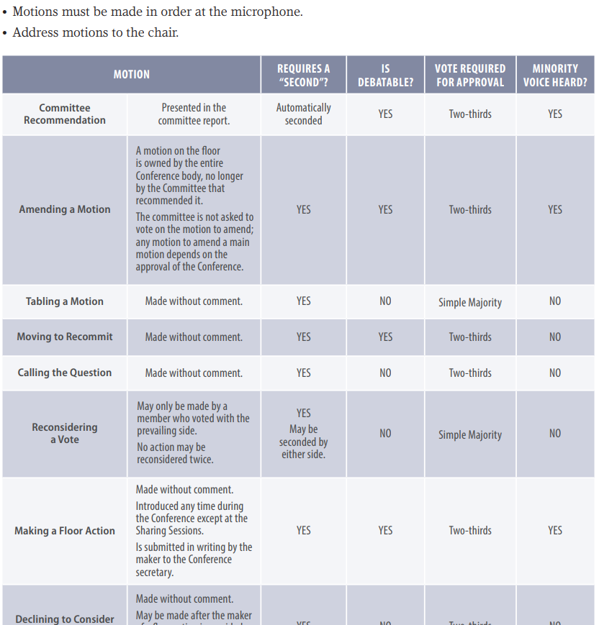
IS THERE A VOTING PROCESS?

Slide 7
THE COMMITTEE SYSTEM, ADVISORY ACTIONS AND FLOOR ACTIONS
“To the extent possible, important matters to come before the Conference are handled via the ‘Committee System’...assuring large number of questions can be dealt with during conference week” (p.41)
Recommendations coming out of committee that pass with 2/3 approval of the Conference members become advisory actions.
Items presented by members, not through a committee which receive 2/3 approval of the Conference members are known as floor actions. These too, become advisory actions.
Recommendations either out of committee or floor actions that do not receive 2/3 approval (aka do not receive substantial unanimity) are considered “suggestions” and are referred to the GSB for consideration.

Slide 8
WHAT DOES THE WEEK LOOK LIKE?
Committees meet Mondays and Tuesdays in the morning
Reports from 3 Corporate Boards and the GSB Treasurer are usually Monday
Committee recommendations start Wednesday
Regional and Trustee at Large elections are usually Wednesday
Thursday and Friday are Committee recommendations, discussion and voting
Friday night - After all committees have reported and the last floor action is heard - the Conference closes

Slide 9
SUGGESTIONS FOR LEARNING MORE
Go through all 12 Traditions with someone
Read:
Chapter 6 in SVM
Concept I
the Conference Charter (original & Current)
Concept II essays
Talk to our Delegate, past Delegates or Trustees about their expereiences at the Conference
Review a Final Conference Report (available for free on AA.org
or you can get a published book copy)

